Slide 1
19CSE313 – Principles of Programming Languages
Course Administrivia and Introduction

Slide 2
Course code and title
Course Code: 19CSE313
Title: Principles of Programming Languages
L-T-P-C: 2-0-3-3

Slide 3
Course objectives
This course provides a quick overview of different paradigms of programming languages.
It focuses primarily on the functional programming paradigm using Haskell and Scala and discusses the concurrent programming paradigm using Java.

Slide 4
Course outcomes and co-po mapping
CO1: Understand and write pure functional programs (especially in Haskell and Scala).
CO2: Understand and write concurrent programs in Java.
CO3: Formulate abstractions with higher order procedures.
CO4: Formulate abstractions with data.

Slide 5
syllabus
Unit 1
Programming Paradigms Overview of different programming paradigms. Functional Programming with Haskell functions and types, functional composition, numbers, lists, tuples, type classes, pattern matching, higher order functions: currying, lambdas, maps and filters, folds, IO monad
Unit 2
Concurrency in Java - Issues with concurrency: safety, liveness, fairness, Threads, locks and synchronization, Threadpools, Futures and callables, fork-join parallel framework
Unit 3
Functional Programming overview with Scala Basic types and operations, classes and objects, functional objects, functions and closure, composition and inheritance

Slide 6
Text Books and references
Text Book(s)
Bird R. Thinking functionally with Haskell. Cambridge University Press; 2014.
Martin Odersky, Lex Spoon and Bill Venners, “Programming in Scala A Comprehensive Step-by-Guide”, Third Edition, Artima Inc. 2016.
Reference(s)
Herbert Schildt. Java: The Complete Reference. Eleventh Edition, McGrawHill Education; 2018.

Slide 7
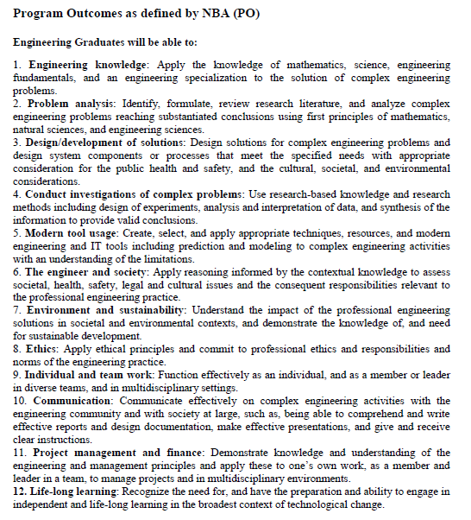

Slide 8
Vision
To be acclaimed internationally for excellence in teaching and research in Computer Science & Engineering, and in fostering a culture of creativity and innovation to responsibly harness state-of-the-art technologies for societal needs.
Mission
1. To assist students in developing a strong foundation in Computer Science and Engineering by providing analytical, computational thinking and problem solving skills.
2. To inculcate entrepreneurial skills to develop solutions and products for inter- disciplinary problems by cultivating curiosity, team spirit and spirit of innovation.
3. To provide opportunities for students to acquire knowledge of state-of-the-art in Computer Science and Engineering through industry internships, collaborative projects, and global exchange programmes with Institutions of international repute.
4. To develop life-long learning, ethics, moral values and spirit of service so as to contribute to the society through technology.
5. To be a premier research-intensive department by providing a stimulating en- vironment for knowledge discovery and creation.
-long learning

Slide 9
PEOs and PSOs
Programme Educational Objectives (PEOs)
PEO1: Strive on a global platform to pursue their professional career in Computer Science and Engineering.
PEO2: Contribute to product development as entrepreneurs in inter disciplinary elds of en- gineering and technology.
PEO3: Demonstrate high regard for professionalism, integrity and respect values in diverse culture, and have a concern for society and environment.
Program Specic Outcomes (PSOs)
PSO1: Adopt Standard Practices: Ability to design and engineer, innovative, optimal and elegant computing solutions to interdisciplinary problems using standard practices, tools and technologies.
PSO2: Research and Innovation: Ability to learn emerging computing paradigms for research and innovation

Slide 10
co-po mapping
CO / PO-PSO | PO1 | PO2 | PO3 | PO4 | PO5 | PO6 | PO7 | PO8 | PO9 | PO10 | PO11 | PO12 | PSO1 | PSO2
CO1 | 1 | 1 | 1 |  | 3 | 2 | 1 |  |  |  |  |  | 3 | 2
CO2 | 2 | 2 | 2 | 1 | 3 | 2 | 1 |  |  |  |  |  | 3 | 2
CO3 | 3 | 3 | 3 | 3 | 3 | 2 | 2 |  |  |  |  |  | 3 | 2
CO4 | 3 | 3 | 3 | 3 | 3 | 2 | 2 |  |  |  |  |  | 3 | 2

Slide 11
Evaluation Pattern
Assessment | Internal | External
Mid term | 20
*Continuous Assessment (Theory) (CAT) | 10
Continuous Assessment (Lab) (CAL) | 40
End Semester |  | 30
*CA Can be Quizzes, Assignment, Projects, and Reports.

Slide 12
Continuous Assessment Theory (CAT):
S.No | Assessment | Weightage
1. | Quiz 1 – CO1, CO3, CO4 | 5
2. | Tutorial 1 – CO1, CO2, CO3, CO4 | 5
Total |  | 10

Slide 13
Continuous Assessment Lab (CAL):
S.No | Assessment | Marks
1. | Evaluation Lab 1 (Functional Programming and Higher order procedures in Haskell) | 15
2. | A case study on Functional Paradigm with concurrency in Contemporary Languages Procedural Abstraction (4 Marks) Data Abstraction (3 Marks) Concurrency (3 Marks) Test Case and Plagiarism Check (5+5 Marks) ( Plagiarism < 10% - 5 Marks; 11%-30% - 3 Marks; >30% - 1 Mark) One Review at the end of the February, 2025. ( Total of 20 Marks) | 10
3. | Evaluation Lab 3 (Data abstraction in Scala) | 15
Total |  | 40

Slide 14
Evaluation timeline
Commencement: Dec 4th , 2024.
Lab Evaluation – 1 ( up to Tuples in Haskell) : Jan 6 – 10
Quiz 1 ( Unit – 1 Full ) : Jan 24 -25
MidTerm : Feb 4th, 2025.
Lab Evaluation – 2 (Case Study): Feb 24 – 28
Tutorial –March 2nd week
Lab Evaluation-3(Scala)-March last week
Last Instruction Day: April 6th, 2025
End Exam: April 7th, 2025.

Slide 15
Online tools required
Lab Software: Haskell, Scala and Java for lab (Offline (free) / Online Versions) – Tools - Notepad and respective compilers
Instruction Materials: E-Books available and In-house PPTs

Slide 16
Thank you

